Slide 1
CISA Procurement
Faculty and Staff Overview
Notes:
The following presentation will provide an overview for the CISA Procurement process for all faculty and staff.

Slide 2
Collect the applicable documents needed for your
Purchase or Reimbursement Request
1.
See the CISA Business Services Guide for the documentation needed which may include:
Receipts
Purchase Request Form
Vendor website
Business Meal Form
Redacted image of card
Quotes
Purchasing Delegation Letter
Notes:
To ensure your ticket is handled in a timely manner, please ensure all necessary documentation is attached. The examples above may or may not apply to your specific need. If you are unsure off the type of documentation you need to attach to your WRIKE ticket, you can review the CISA Business Services Guide, hyperlinked in the above slide, for more information.
If you still have questions or concerns regarding the additional materials for the purchase or reimbursement request, please contact a Finance Team member. We are more than happy to discuss the documents with you!
Also, if you submit a request without the applicable documentation, the request may be delayed.

Slide 3
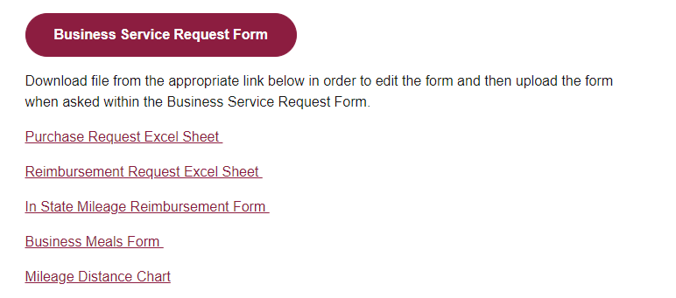
2.
Download and fill out the applicable form(s) (links found on the Finance and Business Support page of the CISA Employee website)
Notes:
Sometimes requests require additional forms that can be located on the Finance and Business Support page, hyperlinked above. It is important to download the applicable form, fill it out to the best of your knowledge, and attach it to the WRIKE form.
If you are planning a business meal, such as an on-campus meeting, the Business Meal Form must be filled out, signed, and returned prior to the event taking place. If the BMF is not attached, the Purchase Request will not go through Workday approval. It is important to fill out the form to the best of your ability.

Slide 4
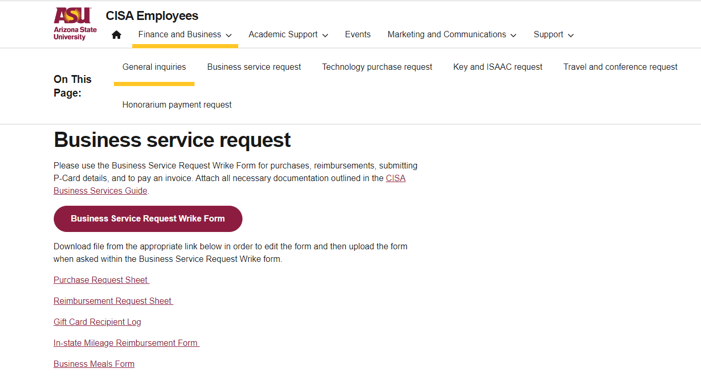
3.
Complete and submit the
Business Service Request Wrike Form
found on the Finance and Business Support page of the CISA Employee website
Don’t forget to attach your documents when submitting the Service Request!
Notes:
After all your applicable documentation has been gathered, the next step will be to complete the WRIKE form.
Before filling out the form on the Finance and Business Support page, please remember to sign into myASU.

Slide 5
A Finance Team Member will review your Wrike form and contact you for any additional information that may be needed.
They will then route your request to the necessary approvers as required for your purchase/reimbursement and funding source.
After your request is approved, a member of CISA’s Business & Finance Team will start the purchase/reimbursement process and contact you.
Notes:
Sometimes the Finance Team will need additional information, and we will reach out to you as soon as possible so the request does not experience significant delays.
After the Finance Team reviews the ticket, the new procurement approval process will begin. SASA, SCCP, and SAPS have their own approval flow charts for Faculty Heads and/or School Directors.
This new process mimics the CISA Travel Approval process, which in turn, helps the Finance Team process tickets in a timely, efficient manner.
Once the request is fully approved, and the reimbursement or procurement request has been completed/ordered, a Finance Team Member will send a follow-up email with pertinent information.
For reimbursements, you will be emailed a general link to the FMS-Workday Homepage where you will login and approve your reimbursement requests. This email also includes the reimbursement request number and always starts with EXP. If you are unable to locate the EXP number, please reach out to a Finance Team Member.

Slide 6
CISA Procurement Flowchart*
SAPS & SCCP
Request processed by Finance Team
Faculty/Staff
*Approval flow when using School funds (does not apply to grant/start-up/RID/etc. accounts)
Finance
Ticket approved
Faculty/Staff
Finance
SAPS Director
SCCP Director
CISA Business Services Form Submitted
Form sent for Approval
Request Denied
Finance
Denial reason sent
Faculty/Staff
Notes:
SAPS and SCCP requests will be approved by the SAPS and SCCP directors, respectively.
If you are placing a request that involves a grant, start-up account, RID/IIA, etc., your ticket will not go through Director-level approval. When this occurs, a Finance Team member will be in direct contact with you.

Slide 7
CISA Procurement Flowchart* SASA
Request processed by Finance Team
Faculty/Staff
*Approval flow when using School funds (does not apply to grant/start-up/RID/etc. accounts)
Finance
Ticket Approved
Ticket Approved
Faculty Head
SASA Director
Faculty/Staff
Finance
CISA Business Services Form Submitted
Form sent for approval
Request Denied
Request Denied
Finance
Finance
Denial reason sent
Denial reason sent
Faculty/Staff
Faculty/Staff
Notes:
The flowchart for SASA involves a Faculty Head approval prior to obtaining Director approval. This flow chart only applies if you are using School funds for a procurement request.

Slide 8
CISA IT Procurement Flowchart* College-wide
*Approval flow when using College funds (does not apply to grant/start-up/RID/etc. accounts)
Request processed by Finance Team
Faculty/Staff
Ticket Approved
Ticket Approved
Faculty/Staff
CISA IT
Finance
Lori Bello
CISA Technology Support page
Ticket Approved
Request Denied
Request Denied
Software Security Review
Faculty/Staff
CISA IT
Faculty/Staff
CISA IT
Denial reason sent
Denial reason sent
Technology Purchase Request
Notes:
The CISA IT department flowchart will apply college-wide and only applies if College funds are being utilized. When submitting a technology ticket, you will need to ensure Technology Request is suggested.
These requests will go from CISA IT to the Finance Team and must receive Lori Bello’s approval, unless otherwise stated by IT.

