Slide 1
CISA Travel
Faculty and Staff Overview
Notes:
This is an overview of the CISA Travel procedure for faculty and staff.

Slide 2
1.
Research your destination
(see Travel Guidance )
Review the CISA Travel Guide
(found on the Finance and Business support page )
Collect the applicable documents
(listed in step 2 of the CISA Travel Guide)
Notes:
The first step is to research your destination. This step is important to ensure you set up your trip request correctly. Using the travel guidance link and the CISA Travel Guide will help you in being confident that you have all the needed information and, possibly, forms needed for your travel destination. For example, if you are travelling internationally a supplemental travel form is required to submit with your travel request.

Slide 3
2.
Complete and submit the CISA Travel Request Form found near the bottom of the Finance and Business support page of the CISA Employee website
Notes:
Once you have all your information and appropriate documents collected, you will complete the CISA Travel Request Form that is found on the Fiscal and Business Support page.

Slide 4
A Finance team member will review your Wrike form and contact you for any additional information that may be needed.
They will then route your request to the necessary Faculty Head and/or School Director approver(s) as required for your travel.
After your travel is approved, the delegate will start a new Trip Request in your My ASU Trip/Concur account, attach your documents, and notify you to proceed.
Notes:
Once you submit your Wrike travel request (the link on the CISA Travel Request Form), it will be directed to the finance team. The team will review the request and route it for approvals. If anything is needed for approval the finance team will reach out to you directly. Upon the ticket being fully approved, the finance team will send you an email with the wrike ticket attached letting you know that you have full approval and it is time to create your Concur trip request.

Slide 5
3.
Add the Finance team members as delegates in My ASU Trip/Concur
Nicole Giver
Gabriella Glennen
Instructions to add a delegate start on page 5 of the
My ASU Trip Manual
* Be sure to check all the boxes to grant permissions to the delegates
Notes:
It is important to go into the settings of your Concur account and have Nicole Giver and Gabriella Glennen as delegates, with all permissions checked, so that they can help you set up your trip requests and expense reports.

Slide 6
4.
Complete Trip Request
Log into My ASU Trip/Concur
Add your Expected Expenses (see page 38)
Submit the Trip Request
Notes:
To complete your trip request in Concur you will: log into your Concur account, add all of your expected expenses totaling to the approved trip amount from the wrike ticket, attach the wrike ticket and any documentation needed according to travel type (i.e. conference brochure), adjust the approval flow to reflect Nicole Giver as Cost Center Manager and Gabriella Glennen as User Added Approver and then submit the trip request.

Slide 7
5.
Book Travel Arrangements
After your My ASU TRIP/Concur Trip Request is marked “Approved” you are authorized to book your travel.
Airfare can booked through My ASU TRIP/Concur using the ASU Airfare (Ghost) card or through another platform
Conference registration fees can be paid by Finance team’s P-cards (please contact your delegate for assistance)
For help with bookings, please contact Anthony Travel 1(844)682-5052
International travelers who do not book through My ASU Trip/Concur, must Manually enter itinerary in Concur before their travel start date
Notes:
Once you receive full Concur approval, you will receive an email letting you know from the Concur automated system that you are fully approved. It is after you have received both wrike and Concur approval that you can begin booking travel arrangements.

Slide 8
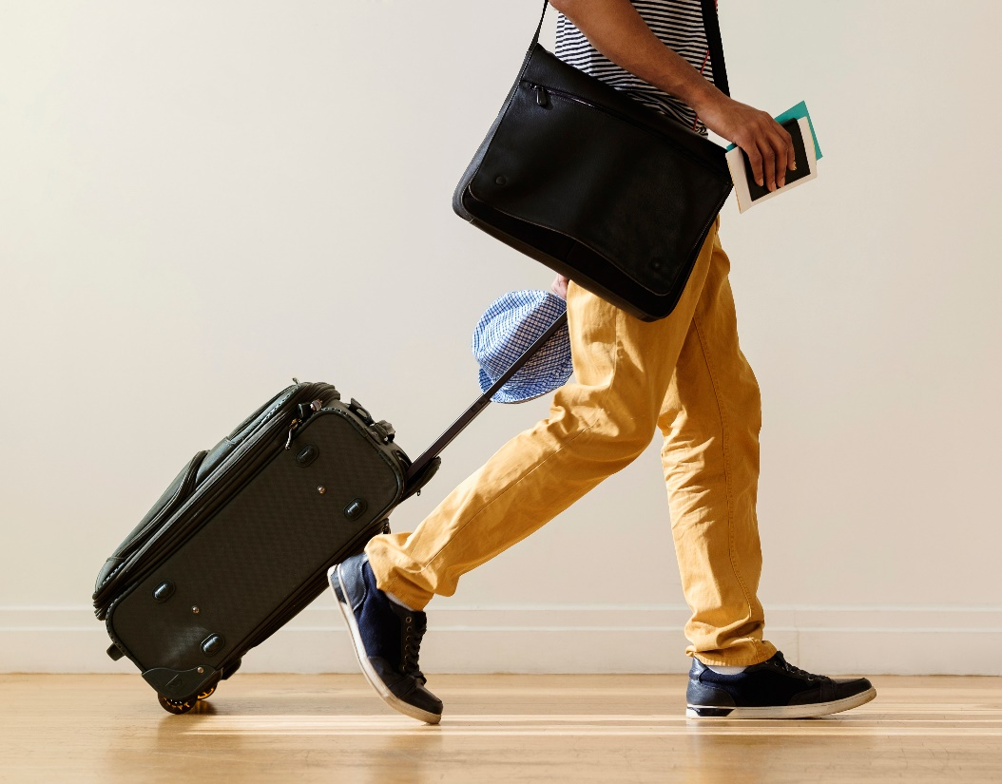
6.
Collect itemized travel receipts for out-of-pocket expenses over $50
(a picture of the receipt is acceptable)
Request a hotel folio at checkout showing:
Your name
Name and address of establishment
Itemized expenses (i.e., room rate, taxes, room service, etc.)
Proof of payment
Notes:
During travel status, it is important that you keep itemized receipts for any out-of-pocket expenses totaling over $50 (such as meals or uber trips). You must also gather an itemized hotel folio upon checkout.

Slide 9
7.
Create and submit Expense Report
Must be completed within 20 days of travel end date
Contact your Finance team delegate before submitting to have the report reviewed and Approval Flow edited to expedite your reimbursement
Instructions start on page 77 of the My ASU Trip Manual
Notes:
Upon returning from your trip you must create an expense report. The report needs to be linked to the approved Concur trip request. To do this you will go into your Concur account and click on the approve trip request and there will be a blue button link for "Create Expense Report". Expense reports are required to be submitted within 20 days of travel end date. You will need to update the approval flow for this report, same as the trip request, with Nicole Giver as Cost Center Manager and Gabriella Glennen as User Added Approver.

Slide 10
CISA Travel Flowchart
SAPS
SCCP
Concur Trip Request created
Finance
Faculty
Travel Approved
Faculty
Finance
SAPS Director
SCCP Director
CISA Travel Request Form Submitted
Form sent for Approval
Request Denied
Finance
Denial reason sent
Faculty
Notes:
For SAPS and SCCP: the finance team routes approvals to the Director.

Slide 11
CISA Travel Flowchart SASA
Concur Trip Request created
Faculty
Finance
Travel Approved
Travel Approved
Faculty Head
SASA Director
Faculty
Finance
CISA Travel Request Form Submitted
Form sent for Approval
Request Denied
Request Denied
Finance
Finance
Denial reason sent
Denial reason sent
Faculty
Faculty
Notes:
For SASA: the finance team routes approval to the correct Faculty Head and then to the SASA Director.

